Slide 1
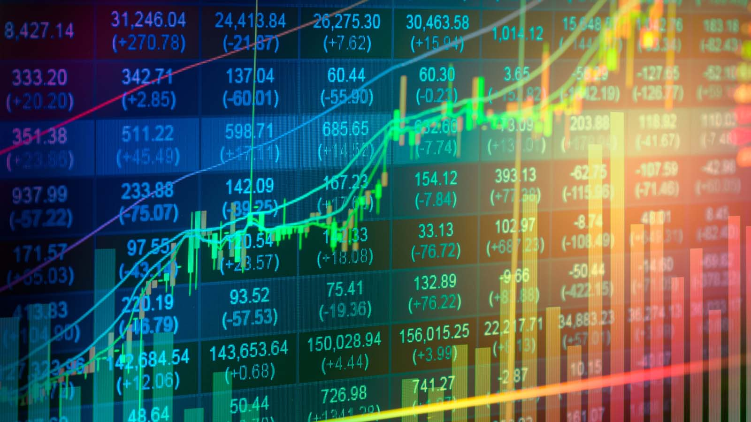
Notes:
Human investors have their own tools. My mom who is a stock investment consultant has her techniques.
Now with technology such as AI we can enhance the potential of stock price prediction

Slide 2

LISTENING TO CHAOTIC WHISPERS:
A DEEP LEARNING FRAMEWORK FOR NEWS-ORIENTED STOCK TREND PREDICTION
Notes:
Basically how to make a stock price prediction based on online news influence

Slide 3
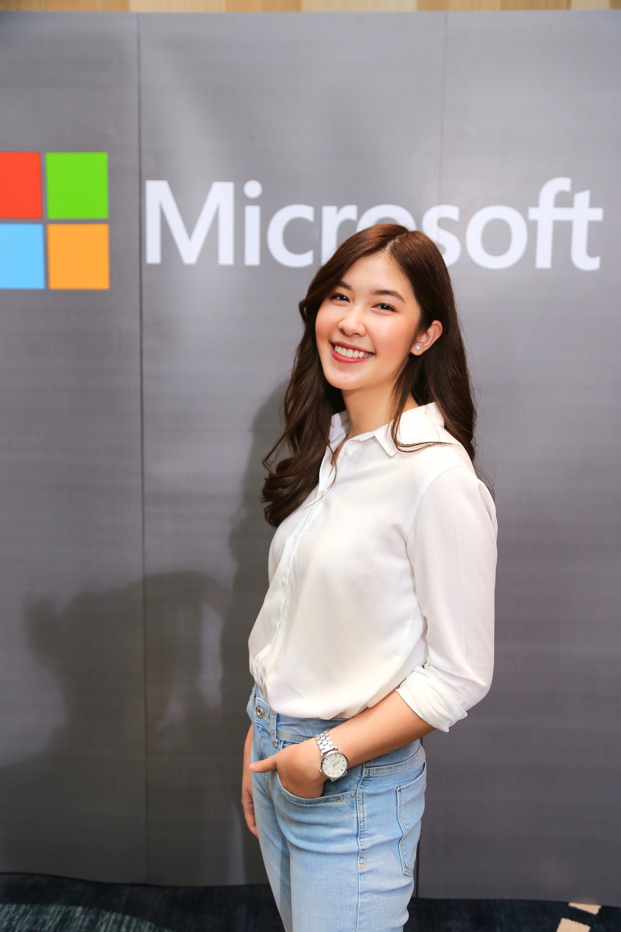



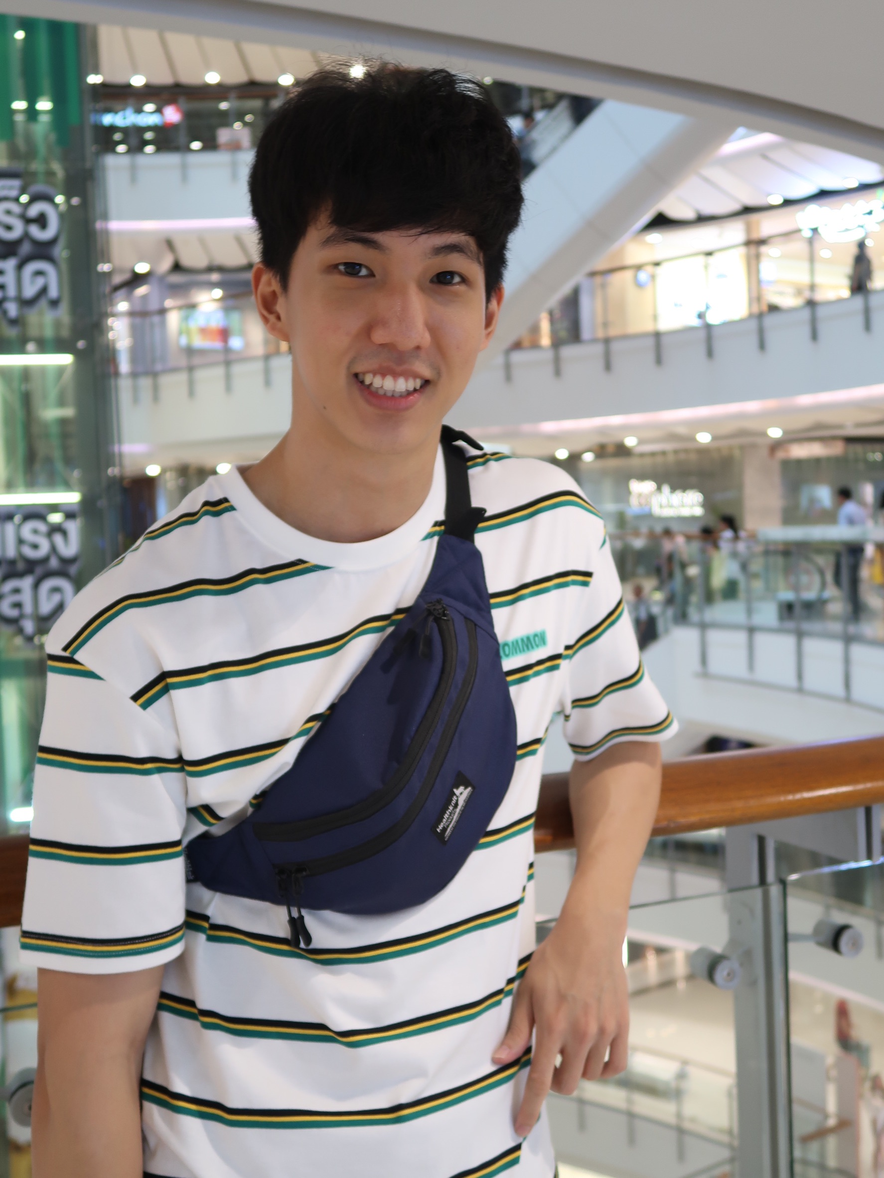
Boonsita Vatcharakomonphan (Queenie)
Satsawat Suttawuttiwong
(Bingo)
Thunyasorn Pornkraisri (Tram)
Anon Pongsawang
(A)
Thanakorn Prayoonkittikul (P)

Slide 4
AGENDA
Related Works
Proposed Work
Conclusion
Introduction to Stock Price Prediction
Human Learning Process
Evaluation

Slide 5
INTRODUCTION TO STOCK PRICE PREDICTION

Slide 6
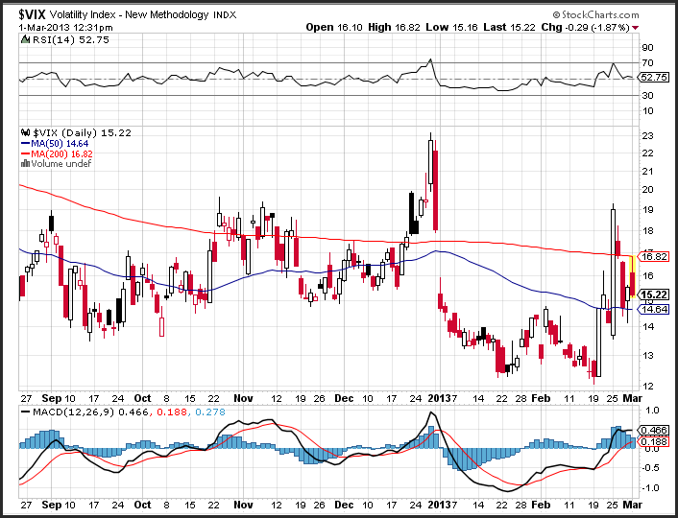
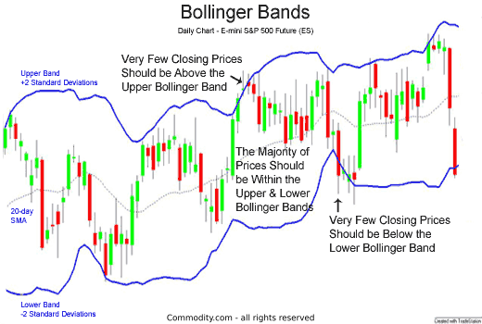
Fundamental Analysis
Company business model
Quarterly balance sheet
Price per earning ratio
Technical Analysis
Stock technical chart
Moving average
Bollinger band
MACD
News
World / Domestic Economy Status
STOCK INVESTOR’S TOOLS IN MAKING STOCK PRICE PREDICTION
01
02
03
04
Notes:
Fundamental analysis measures stock price by considering related economic and financial factors. Quarterly balance sheet is a good example because you can clearly see how well or how bad the business is going. The stock price would behave in relative to the well being of the firm.
Technical analysis forecasts the direction of prices through an analysis of historical market data such as price and volume. Moving average can be used to decide where should the selling orders start in according to the price. Most people would start selling the stock when its price goes below its 200 days moving average. If a large number of traders do the same thing, the stock price will be pushed down further.
For number 3 and number 4 I arbitrarily added myself from an interview with my mother who is a stock investment consultant. She explained that news and the economy do affect stock price since, in the end, it’s all psychology. For example, the death of Steve Jobs would definitely affect the stock price of Apple due to people being uncertain of the next CEO’s skills. Regarding the economy status, the stock price of a company that exports food from Thailand to the US wouldn’t be greatly affected by the economic recession within Thailand as long as the economy in the US is still up and going. Up next, A will tell us about this topic’s related work.

Slide 7
RELATED WORK

Slide 8
RELATED WORK
1
Technical Analysis
2
Fundamental Analysis

Slide 9
Technical Analysis
AUTOREGRESSION (AR) MODEL FOR LINEAR AND STATIONARY TIME-SERIES
LONG SHORT-TERM MEMORY (LSTM) NETWORK
STATE FREQUENCY MEMORY (SFM) NETWORK
Past values have an effect on current values
Limitation: Non-linear and non-stationary nature of stock prices
Modified version of recurrent neural networks
Easier to remember past data in memory
Resolve vanishing gradient
Limitation: Only consider pattern dependency in time domain
RNN that allows separate dynamic patterns across different frequency
Used to discover multi-frequency trading patterns for stock price
Limitation: Unable to reveal rules beyond price data.

Slide 10
Fundamental Analysis
MULTILAYER DIMENSION REDUCTION
EVENT-DRIVEN STOCK MARKET PREDICTION
TEXT REGRESSION TASK
Natural language processing + Statistical pattern recognition + sentiment analysis
Predicts based on the words used in adjacent news-headlines in the previous few hours
Extract events from news text, and represented as dense vectors
Trained using a novel neural tensor network
CNN model both short-term and long-term influences of events
Novel semiparametric Gaussian copula regression
Predict the volatility of stock prices
NOVEL TREE REPRESENTATION
EXTRACTION OF EXPRESSIVE FEATURES
SENTIMENTAL ANALYSIS
Use SemTree
Predictive models with tree kernels using SVM
Extract large scale of expressive features
Employs robust feature selection
Generic sentiment analysis
Study of tweets to predicted stock by various online emotions
Extract topics relating to the target stocks from social media

Slide 11
However...
Very few of them paid enough attention to the quality, trustworthiness, and comprehensiveness of news

Slide 12
HUMAN LEARNING PROCESS
Notes:
What makes our topic special is the human learning process. By giving the model the ability to comprehend various kinds of news like us, we will see the differences.

Slide 13
HUMAN LEARNING PROCESS
S
SEQUENTIAL CONTEXT DEPENDENCY
D
DIVERSE INFLUENCE
E
EFFECTIVE AND EFFICIENT LEARNING
Notes:
When we humans read news and try to understand contexts and information from them, our learning process can be classified into three principles.

Slide 14
SEQUENTIAL CONTEXT DEPENDENCY
DIVERSE INFLUENCE
EFFECTIVE AND EFFICIENT LEARNING
S
D
E
Relying on sequence of news and combining them into a unified context to make prediction
To imitate a human’s analysis process, an ideal framework should integrate and interpret each news in a sequential temporal context, rather than analyze them separately.
Significant news has more intensive and durable influence on the market than trivial ones
When analyzing the news, an ideal framework should have the ability to distinguish the news with more intensive and durable influence, and pay more attention to them.
Gather an overall knowledge by focusing on informative occasions first before turning to disturbing evidence
An ideal framework should conduct its learning on more informative news at the earlier stage, and further optimize to tackle harder samples.
Notes:
Sequential context dependency: If a single piece of news is low-quality, we would consider related news to support the context of the stock. Then we can make a more reliable prediction on the stock trend. We can also pay different attention to various parts of the news sequence up to their importance and influences.
Diverse Influence: Every news have different level of influences. We human beings can tell from the context of the news. Some breaking news would hugely affect the trend of related stocks. In real-world investment, investors tend to consider the estimated impact of each news at the time they predict the stock trend.
Effective and efficient learning: Some news do not provide obvious indication on stock trend. So what do we do? We turn to other news with more information first so that we understand what to look for in the news that have less information.

Slide 15
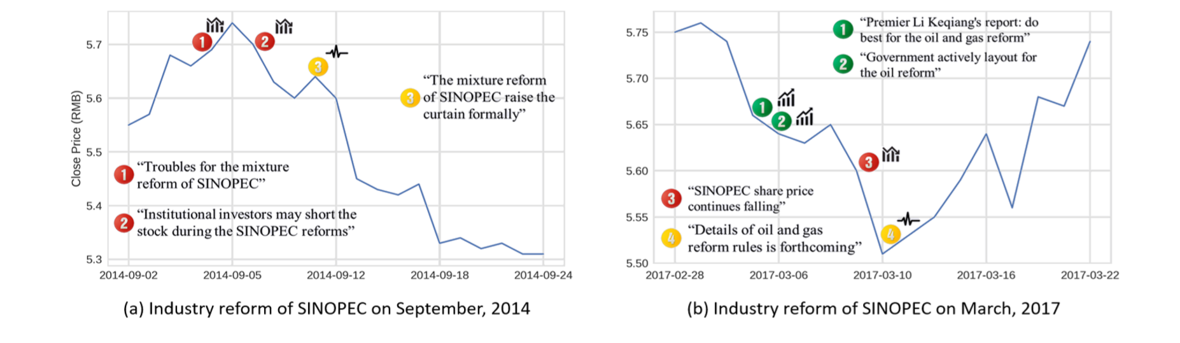
S
D
SEQUENTIAL CONTEXT DEPENDENCY
DIVERSE INFLUENCE
An example of two news sequences about the petrol industry reform, jointly shown with the stock price of SINOPEC that is one of the biggest petrol companies in China.
In the figure, red, green and yellow circles represent negative, positive and neutral news respectively.
Notes:
Sequential Context Dependency In (a) 2 yellow circle = 2 news of industry reform, but it’s hard to tell the trend. So we study previous news in red saying that the reform might cause negative effects on the stock trend. In (b) We study the news in green which informed us of positive signals.
Diverse Influence, in (b) 3rd news say that the share price has been going down. This is a negative signal. But the news report from the petrol industry says otherwise. The stock dropped for only 1 day.

Slide 16
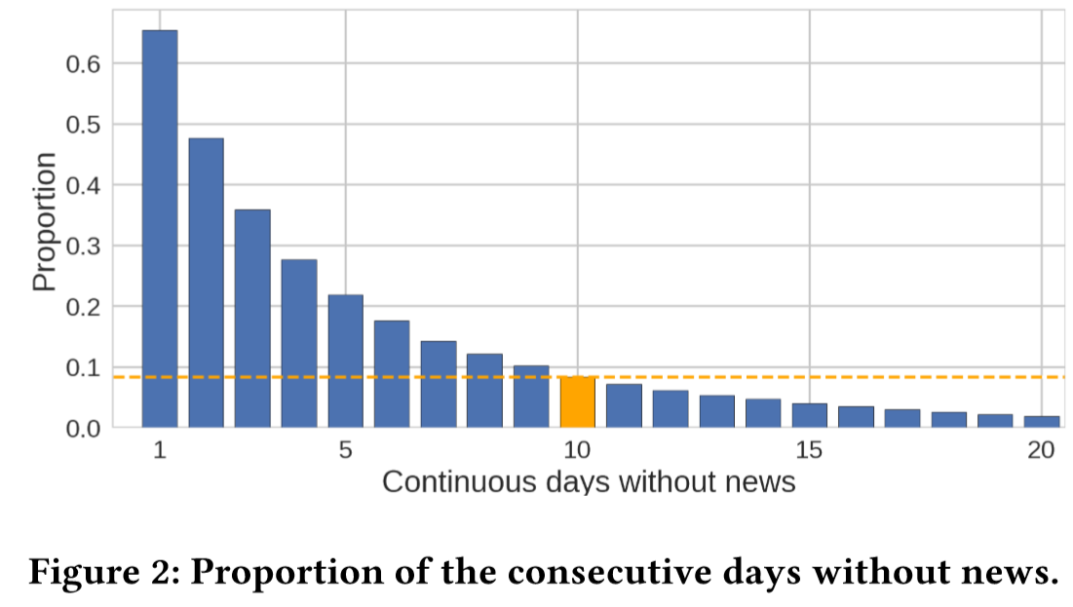
E
Occurrence rates of the situation that there is no news about a particular stock “Jiai Technology” for consecutive l days or more.
Within those 8.4%of time periods when there is no news reported for more than 10 days, it is quite tough to make any news-oriented prediction.
Notes:
No news on this company for consecutive L days or more.

Slide 17
PROPOSED WORK

Slide 18
PROPOSED WORK
Sequential Context Dependency
Diverse Influence
Effective and Efficient Learning
Notes:
In the paper, they propose a model that mimic these human learning process that we’ve mentoned. First, let start with the first two principle

Slide 19
Hybrid Attention Networks (HAN)
Temporal-level Attention
News-level Attention
Interpret and analyze news in the sequential temporal context and pay more attention to critical time periods
Distinguish more significant news from others
D
S
Dependency Influence
Sequential
Context
Dependency
Notes:
The team propose a Hybrid Attention Networks (HAN) which consists of two attention layers.
First, they create news-level attention layer to distinguish which news is more significant than others. Diverse Influence = Checked
They, again, design temporal-level attention layer to interpret and analyze news in the sequential temporal context and pay more attention to critical time periods. Sequential Context Dependency checked

Slide 20
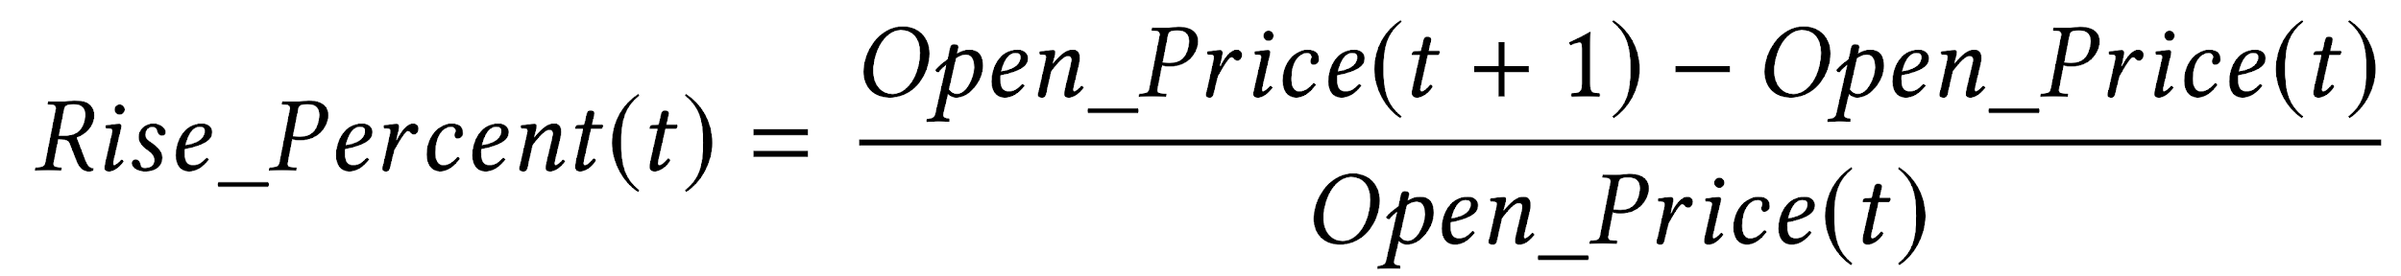
Problem Statement
Stock trend prediction is a classification problem
Given date t and a given stocks s :
Notes:
Before we deep dive into the framework, let’s talk about problem statement. We regard the problem of stock trend prediction asna classification problem. The value they use to classify is rise percent which is basically, it’s how much the open price will rise in the next day.

Slide 21



Problem Statement
Divide rise percent into three classes:
UP
PRESERVE
DOWN
Notes:
Once we get the rise percent value, we can now classify whether the stock trend will be up, preserve, or down.

Slide 22
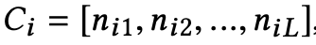
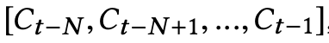
Problem Statement
Each news corpus Cᵢ contain a set of news:
Suppose we consider the news in the time sequence N
The news corpus sequence from time t-N to t-1:
Notes:
Let’s talk about some terms that we need to clarified before talking about the architecture. We denote a variable ci as a set of all news on the date i. We called this Ci a news corpus. So in the sequence of N, we will have the news corpus sequence from Ct-N to Ct-1.

Slide 23
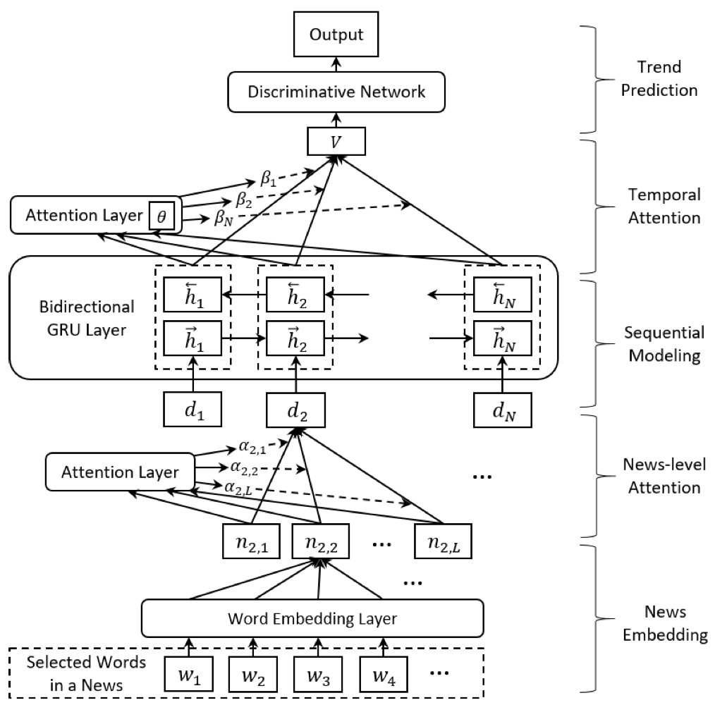
Hybrid Attention Networks
Notes:
Let see the whole architecture of the framework in more detail, layer by layer

Slide 24
News Embedding
Calculate the embedded vector for each word
Average all the words’ vectors to construct a new vector n_{ti}
Word2Vec

Slide 25
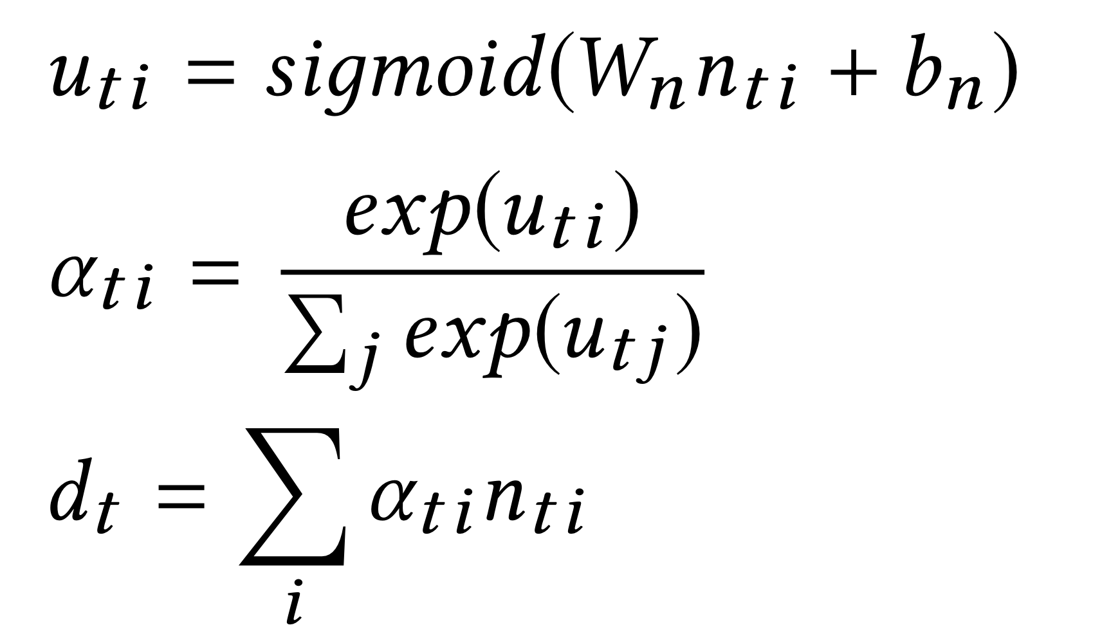
News-level Attention
D
Dependency Influence
Assign news-level attention value u_{ti} to each news
Calculate a weighted sum of each news vector for date t as d_{t}

Slide 26
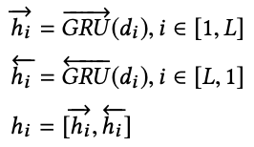
Sequential Modeling
Encode the temporal sequence of corpus vector with Gated Recurrent Units (GRU)
Construct a bi-directional encoded vector h_{i} :
Notes:
The sequential modeling layer receive the overall corpus vector d as a weighted sum of each news vector. (They encode the temporal sequence of corpus vector ) They encode it with Gated Recurrent Units or GRU to check the state of sequences without separate the memory cell.
GRU can also be considered as a variation on the LSTM because both are designed similarly. It can be used to avoid exploding and vanishing gradient problem by two gates (update and reset gates)
The different between GRU and LSTM is that LSTM are more complex and take longer to train but it could remember longer sequence at the cost of increased training time.
They construct a bi-directional GRU to capture the information from the past and the future of a news as its context, which is h_{i} as a result.
//So the result h_{i} unites the information of both its surrounding context and itself.

Slide 27
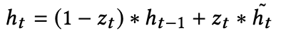
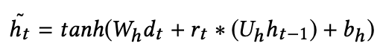
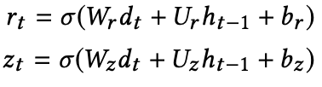
Gated Recurrent Units
GRU computes the news state h_{t} by linearly interpolating the previous state h_{t - 1} and the current updated state (h with ~ accent above):
The current updated news state :
Reset gate and Update gate:
https://towardsdatascience.com/understanding-gru-networks-2ef37df6c9be
Notes:
Let talk a bit more about the GRU mechanism.
In the first equation, the first part determine what information to collect from the previous step and another determine what to collect from the current step.
The current updated state will use the reset gate to help store the relevant information from the past.
The reset gate is used to determine how much information is irrelevant and should be forgotten..
The update gate is used to determine how much the past information(from the previous time steps) needs to be passed to the next time step.
The two gates are calculated by the equation shown here on the slide.

Slide 28
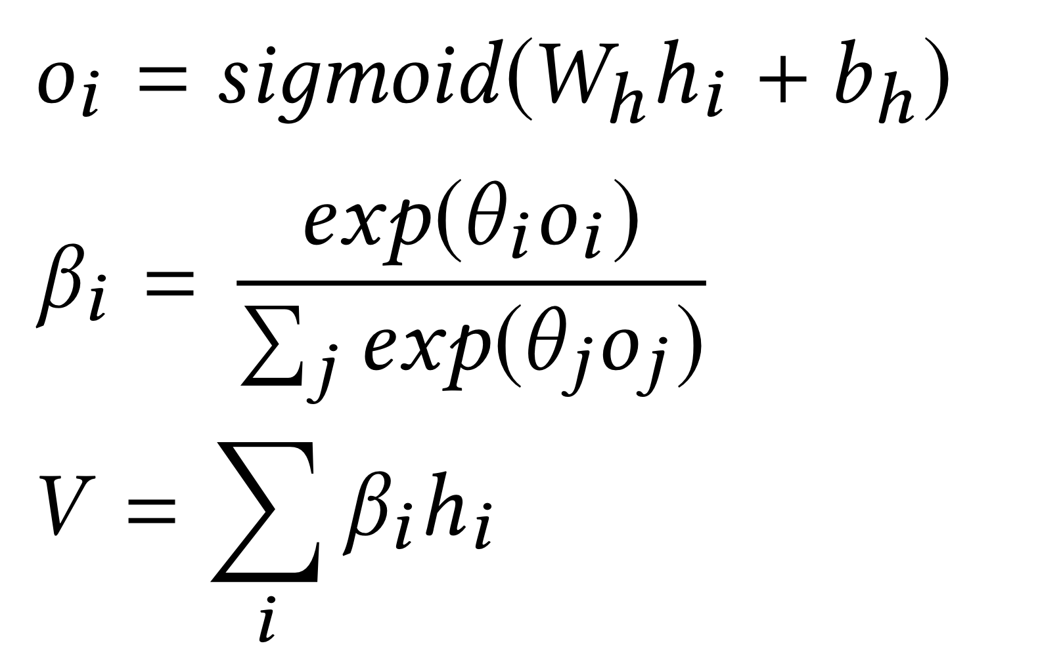
Temporal Attention
S
Sequential Context
Dependency
Distinguish the temporal difference 𝛽
Notes:
Since the news published on different dates
This layer attempts to learn what to pay attention to based on the input sequence seen so far.
They encoded the result from sequential layer with sigmoid function , then indicate which date is more significant by the softmax function, which theta is a weight of each corpus vector.
By combining them to a softmax function, it get attention vector Beta to distinguish the temporal difference
Then use Beta to calculate the weight sum V, so that it can incorporate the sequential news context information with temporal information,.

Slide 29
Trend Prediction
Multi-layer Perceptron (MLP)
Produce three-class classification
Notes:
The final layer is a standard MLP, which take V (from the temporal attention layer) as an input and produce a three-class classification of the future stock trend.

Slide 30
PROPOSED WORK
Sequential Context Dependency ✓
Diverse Influence ✓
Effective and Efficient Learning
Notes:
Next, the third human learning process that the model is going to mimic. The effective and efficient learning.

Slide 31
Challenges
E
Effective and
Efficient Learning
Scarceness of news
Aggregation of vague news
Rumour
The designed model should learning on more informative news first, and further learning on the vague one.
Notes:
The challenge for the model is the scarceness of news or vague news which can cause the learning difficult.

Slide 32
Curriculum Learning
E
Effective and
Efficient Learning
Can imitate the learning process
BUT the sequence of training samples is fixed by predetermined curriculum
Cannot be adjusted to the feedback from the dynamic learned model
Notes:
We can deal against the challenge by the curriculum learning. It start out with only easy examples of a task, skip those challenging training example, and then gradually increase the task difficulty.
By using the curriculum alone, the sequence of training example cannot adjust to the feedback from dynamic learning model.

Slide 33
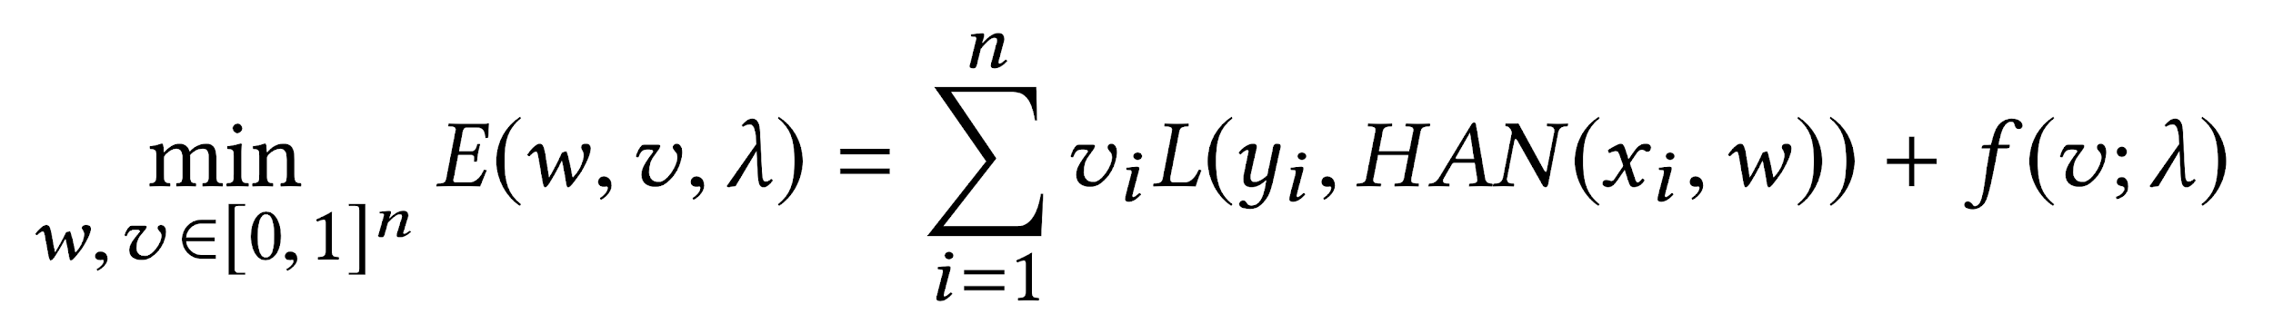
Self-Paced Learning (SPL) Mechanism
E
Effective and
Efficient Learning
Embed curriculum design into the learning objective
Can optimize the curriculum and the learned model simultaneously.
Assign each learning sample an importance weight v_{i}
Help jointly learn the model parameter w and the latent weight v
http://ai.stanford.edu/~pawan/publications/KPK-NIPS2010.pdf
Notes:
So the author introduce self-paced learning or SPL to tackle the previous problem. SPL is embed with curriculum design into learning objective which can jointly optimize the curriculum and the learn model simultaneously.
It help the model learn the news influence in an organized manner.
Next Tram will talk about the evaluation of this model.

Slide 34
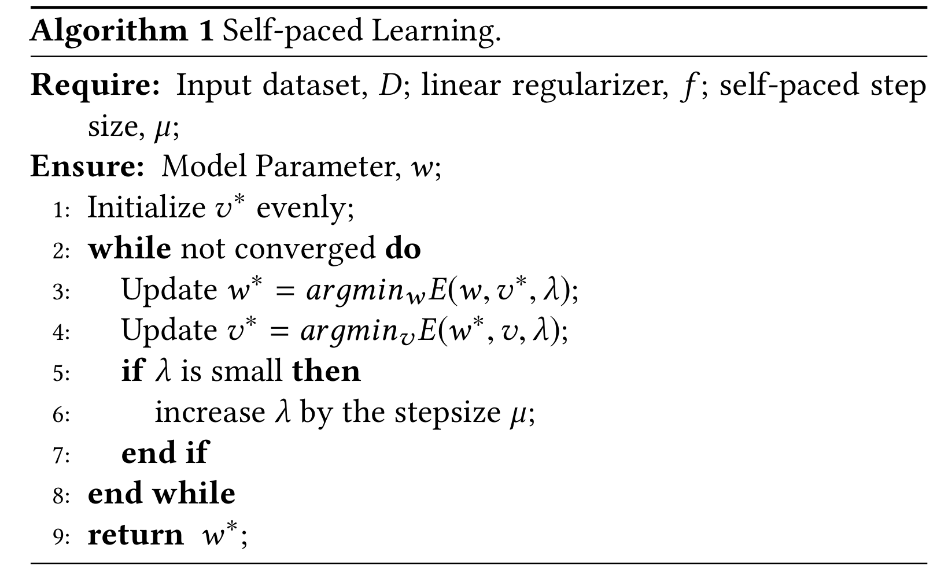
Self-Paced Learning (SPL) Mechanism

Slide 35
EVALUATION

Slide 36
EVALUATION
1
Experiment Setup
2
Effects of Two Attention Mechanisms
3
Effects of Self-paced learning
4
Overall Performance Experiments
5
Performance Discussion

Slide 37
EVALUATION
1
Experiment Setup
2
Effects of Two Attention Mechanisms
3
Effects of Self-paced learning
4
Overall Performance Experiments
5
Performance Discussion

Slide 38


Experiment Setup
1
DATA COLLECTION
Chinese Stock Data
(2014-2017)
Economic News
(2014-2017)
Notes:
Correlate = connect
Data Collection
Chinese stock data (2014-2017)
Including time series in term of price and trading volume
Economic news (2014-2017)
Extracted the publication time stamp, title, and its content
Correlating each of news to a specific stock
Filtering out the irrelevant news

Slide 39
Experiment Setup
1
LEARNING SETTINGS
Label of the classification problem
DOWN: Rise_Percent(t) < -0.41%
Up: Rise_Percent(t) > 0.87%
PRESERVE: -0.41% <= Rise_Percent(t) <= 0.87%
Splitting the data set
Training set: September 2014 to May 2016
Testing set: May 2016 to March 2017
Validation set : 10% randomly selected from training set
Notes:
Correlate = connect
Tokenize is defined as the process of converting physical, real-world assets into a token. A token is a digital representation of an asset that exists on the blockchain.
Learning Settings
Label of the classification problem
DOWN: Rise_Percent(t) < -0.41%
Up: Rise_Percent(t) > 0.87%
PRESERVE: -0.41% <= Rise_Percent(t) <= 0.87%
Splitting the data set
Training set = 66.7% -> September 2014 to May 2016
Testing set = 33.3% -> May 2016 to March 2017
Validation set = 10% randomly selected from training set
Building the vocabulary
Tokenizing each news
Removing the stop words and the words appearing less than 5 times

Slide 40
Experiment Setup
1
COMPARED METHODS
Random forest
Multi-layer Perceptron
News-RNN
One-RNN
Temporal-Attention-RNN
News-Attention-RNN
HAN
HAN-SPL
Notes:
Correlate = connect
Tokenize is defined as the process of converting physical, real-world assets into a token. A token is a digital representation of an asset that exists on the blockchain.
HAN - hybrid attention network
To evaluate the effectiveness of their purposed deep learning framework
Random forest
Multi-layer Perceptron
News-RNN
One-RNN
Temporal-Attention-RNN
News-Attention-RNN
HAN
HAN-SPL

Slide 41
EVALUATION
1
Experiment Setup
2
Effects of Two Attention Mechanisms
3
Effects of Self-paced learning
4
Overall Performance Experiments
5
Performance Discussion

Slide 42
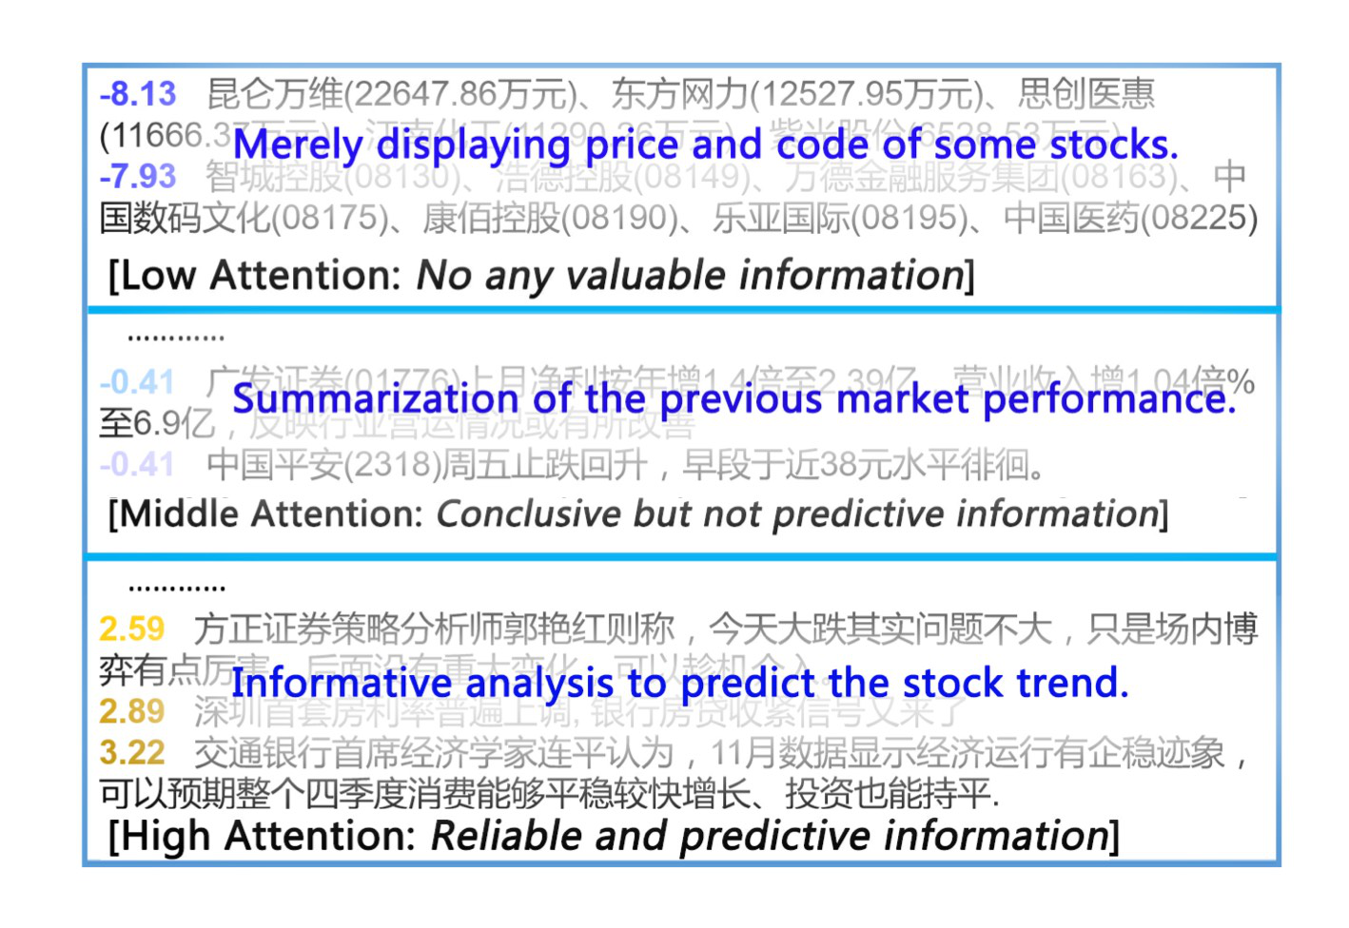
Effects of Two Attention Mechanism
2
DEMONSTRATION ON NEWS ATTENTION
Lowest: price
Middle: previous market performance
Highest: some prediction from official analyst, some significant events
Notes:
Correlate = connect
Tokenize is defined as the process of converting physical, real-world assets into a token. A token is a digital representation of an asset that exists on the blockchain.
Demonstration on News Attention
To validate whether their framework can select significant news and filter out those less information one, this figure show some results
The number in front of the news is the attention value
3 classes: lowest, middle, and highest attention value
Lowest: price
Middle: previous market performance
Highest: some prediction from official analyst, some significant events

Slide 43
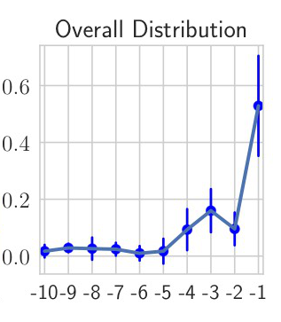
Effects of Two Attention Mechanism
2
VISUALIZATION OF TEMPORAL ATTENTION
Overall Distribution: recently news has more impact on the current stock than the one that reported earlier
Notes:
Correlate = connect
Tokenize is defined as the process of converting physical, real-world assets into a token. A token is a digital representation of an asset that exists on the blockchain.
Visualization of Temporal Attention??
To illustrate the effect of temporal attention, calculate all the temporal attention vectors on the testing dataset
Overall Distribution: recently news has more impact on the current stock than the one that reported earlier
we adopt the spectral cluster method to generate five clusters representing different patterns of temporal attention, as is shown in the first five plots in Figure 5. We can find that despite the overall distribution, in different contexts with different news contents, the attention distribution can be quite diverse as well as dynamic. The informative news even in a few days ago can also express their influences in the temporal attention layer.

Slide 44
EVALUATION
1
Experiment Setup
2
Effects of Two Attention Mechanisms
3
Effects of Self-paced learning
4
Overall Performance Experiments
5
Performance Discussion

Slide 45
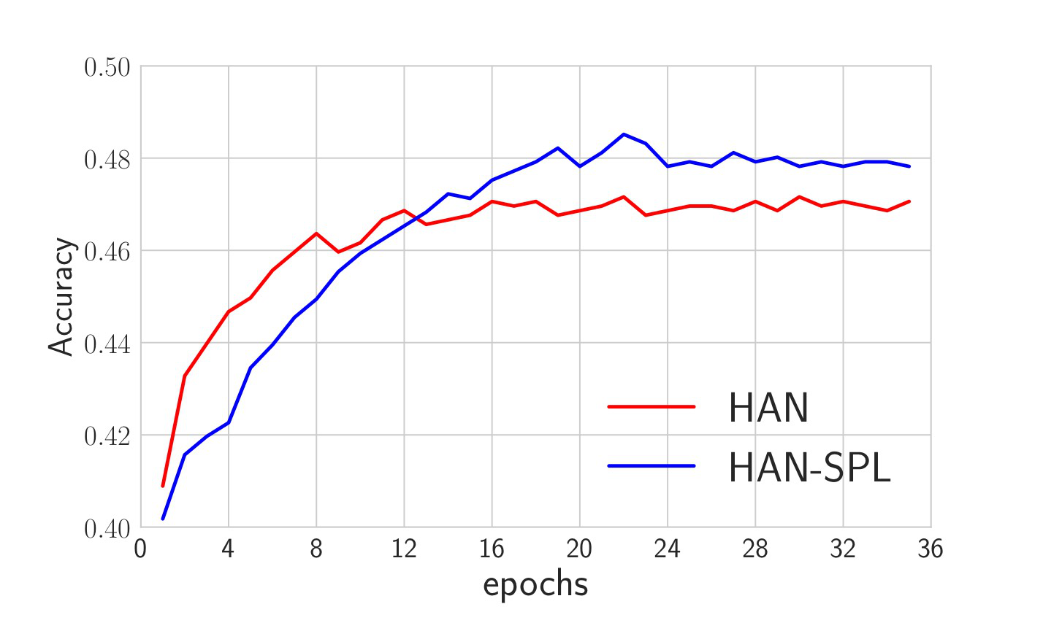
Effects of Self-paced learning
3
EFFECTS OF SELF-PACED LEARNING
Notes:
Correlate = connect
Tokenize is defined as the process of converting physical, real-world assets into a token. A token is a digital representation of an asset that exists on the blockchain.
HAN - hybrid attention network
To evaluate the effectiveness of the SPL, they compare the training process using the SPL with that using the standard learning process

Slide 46
EVALUATION
1
Experiment Setup
2
Effects of Two Attention Mechanisms
3
Effects of Self-paced learning
4
Overall Performance Experiments
5
Performance Discussion

Slide 47
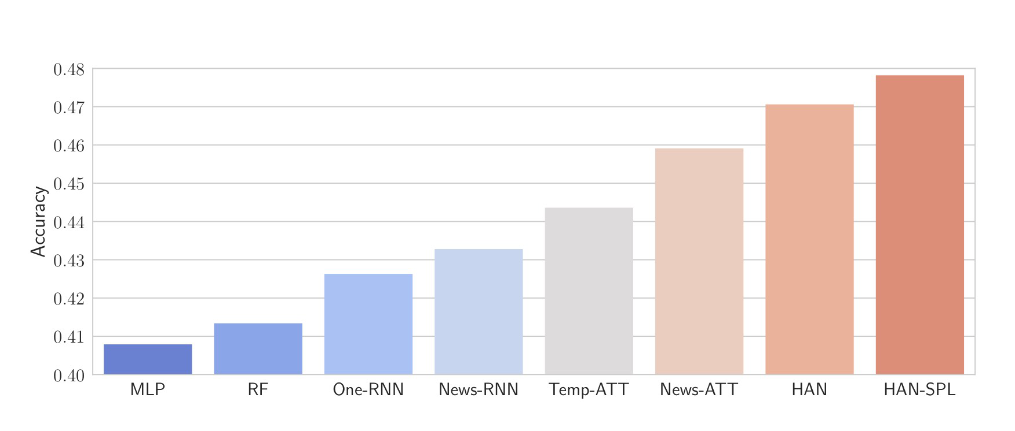
Overall Performance Experiments
3
4
CLASSIFICATION ACCURACY RESULT
Notes:
Correlate = connect
Tokenize is defined as the process of converting physical, real-world assets into a token. A token is a digital representation of an asset that exists on the blockchain.
HAN - hybrid attention network

Slide 48
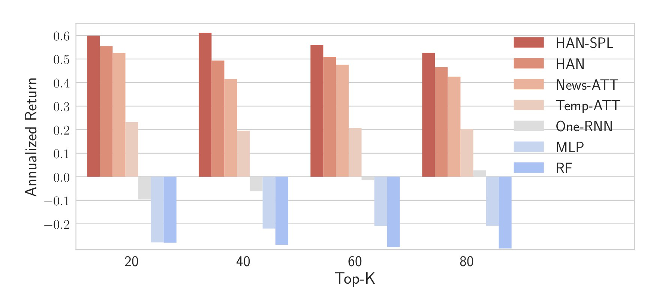
Overall Performance Experiments
3
4
MARKET TRADING SIMULATION
top-K strategy: selects K stocks with the highest scores to construct a new portfolio for the next trading day
Notes:
Metric - a standard measurement
When k = 20, the improvement is not that obvious. This is because selecting few stocks leads to high turnover rate, which cause high transaction cost and offsets the profits
Market Trading Simulation
Conduct a back-testing by simulating the stock trading for approximately one year, from May 2016 to March 2017
At beginning of each training date, the model will give each stock a score based on the probability to have a rising trend minus the probability to have a declining trend
top-K strategy: selects K stocks with the highest scores to construct a new portfolio for the next trading day
Using annualized return(cumulative profit per year) to evaluate the performance
When k = 20, the improvement is not that obvious. This is because selecting few stocks leads to high turnover rate, which cause high transaction cost and offsets the profits

Slide 49
EVALUATION
1
Experiment Setup
2
Effects of Two Attention Mechanisms
3
Effects of Self-paced learning
4
Overall Performance Experiments
5
Performance Discussion

Slide 50
Performance Discussion
5
3
PERFORMANCE DISCUSSION
Best accuracy = 0.478 (from HAN-SPL)
Highest annualized return = 0.611 (investing 40 stocks)

Slide 51
CONCLUSION

Slide 52
CONCLUSION
Three principles for news-oriented stock trend prediction
Sequential context dependency
Diverse influence
Effective and efficient learning
Hybrid Attention Network (HAN) + Self-paced learning mechanism
Experiments on real stock market
Back-testing

